Slide 1
Chapter 1: Introduction
Purpose of Database Systems
View of Data
Data Models
Data Definition Language
Data Manipulation Language
Transaction Management
Storage Management
Database Administrator
Database Users
Overall System Structure

Slide 2
Database Management System (DBMS)
Collection of interrelated data
Set of programs to access the data
DBMS contains information about a particular enterprise
DBMS provides an environment that is both convenient and efficient to use.
Database Applications:
  Banking: all transactions
  Airlines: reservations, schedules
  Universities: registration, grades
  Sales: customers, products, purchases
  Manufacturing: production, inventory, orders, supply chain
  Human resources: employee records, salaries, tax deductions
Databases touch all aspects of our lives

Slide 3
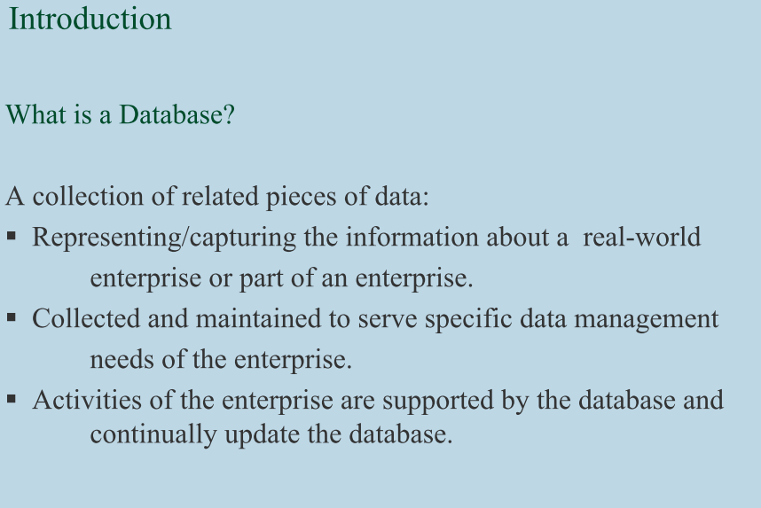
Database Management System (DBMS)

Slide 4
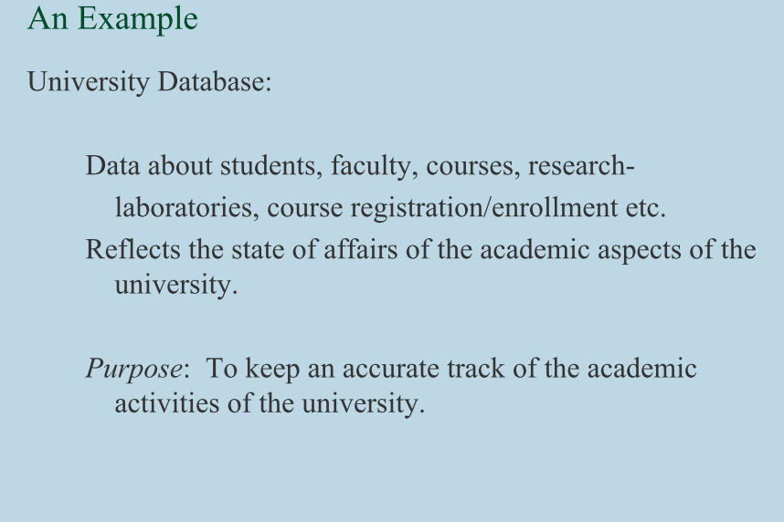

Slide 5
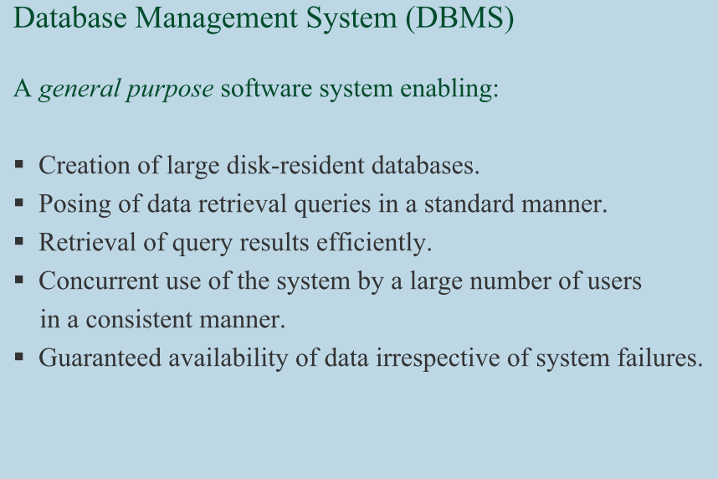

Slide 6
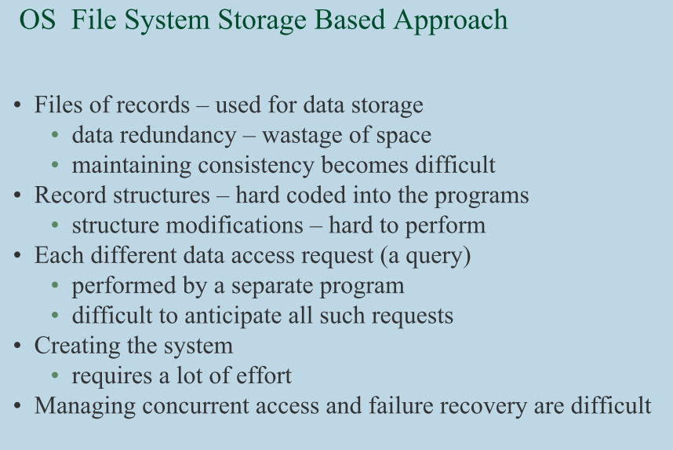

Slide 7
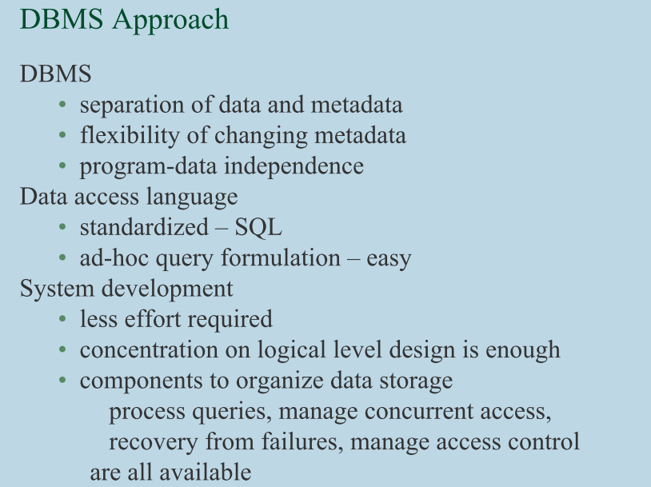

Slide 8
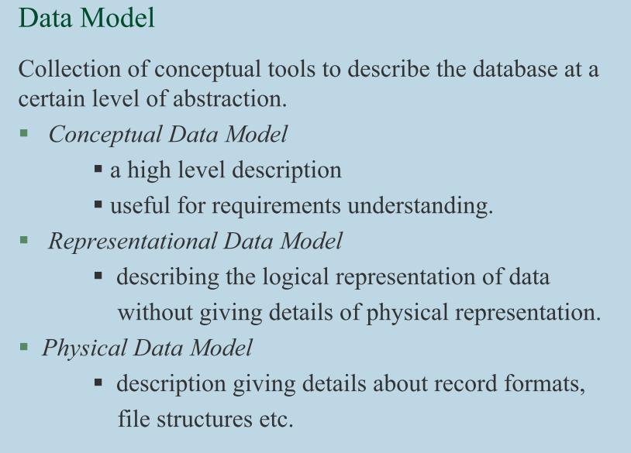

Slide 9
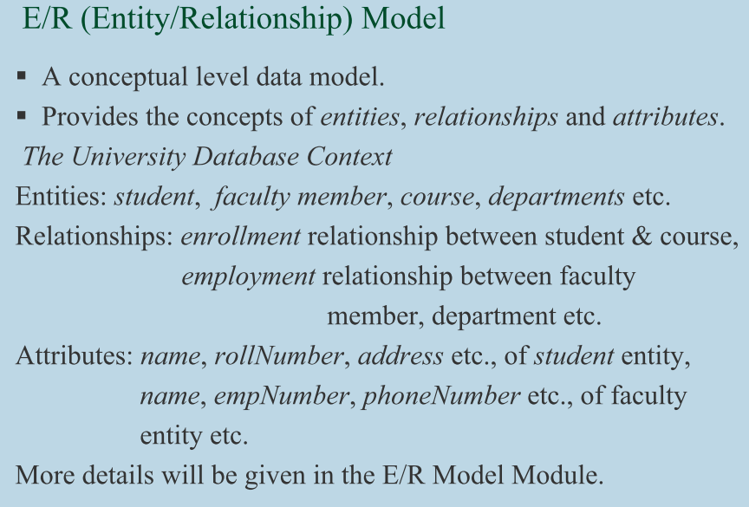

Slide 10
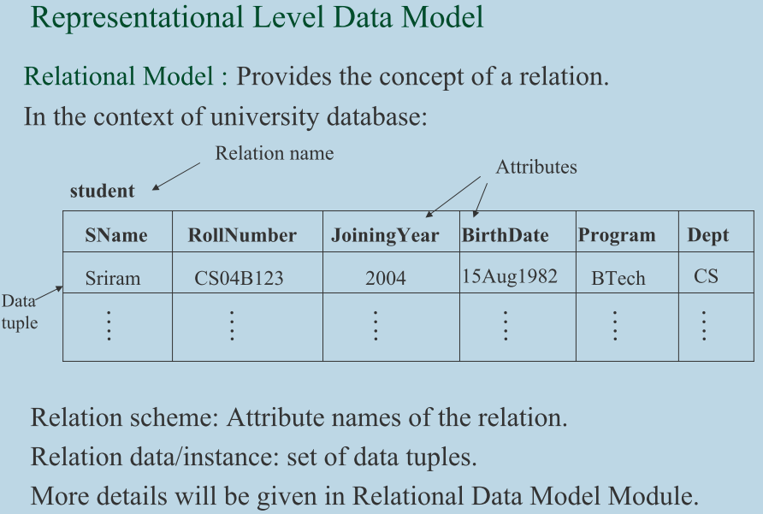

Slide 11
Relational Model
Attributes
Example of tabular data in the relational model
Customer-id
customer-
name
customer-
street
customer-
city
account-
number
192-83-7465
019-28-3746
192-83-7465
321-12-3123
019-28-3746
Johnson
Smith
Johnson
Jones
Smith
Alma
North
Alma
Main
North
Palo Alto
Rye
Palo Alto
Harrison
Rye
A-101
A-215
A-201
A-217
A-201

Slide 12
Advantages of Using a DBMS
persistent objects, types and data structures
control of concurrent users
controlling of redundancy
restricting access (security)
representation of complex relationships
and integrity constraints
backup and recovery
multiple user interfaces and user views

Slide 13
Purpose of Database System
In the early days, database applications were built on top of file systems
Drawbacks of using file systems to store data:
  Data redundancy and inconsistency
    Multiple file formats, duplication of information in different files
      Higer Storage and access cost
      Data inconsistency
  Difficulty in accessing data
    Need to write a new program to carry out each new task
  Data isolation — multiple files and formats
    Writing new program to retrieve data is difficult.
  Integrity problems
    Integrity constraints (e.g. account balance > 0) become part of program code
    Hard to add new constraints or change existing ones

Slide 14
Purpose of Database Systems (Cont.)
Drawbacks of using file systems (cont.)
  Atomicity of updates
    Failures may leave database in an inconsistent state with partial updates carried out
    E.g. transfer of funds from one account to another should either complete or not happen at all
  Concurrent access by multiple users
    Concurrent accessed needed for performance
    Uncontrolled concurrent accesses can lead to inconsistencies
      E.g., two people reading a balance and updating it at the same time
  Security problems
Database systems offer solutions to all the above problems

Slide 15
View of Data: Levels of Abstraction
View of Data:
  Data base system provide abstract view of data to users.
  Hides certain details of how data are physically stored & maintained.
Physical level: describes how data is actually stored.
  Lowest level of abstraction
  Describes complex and efficient low-level data structure in details
Logical level: describes what data are stored and what relationships exists among them.
type customer = record
name : string;
street : string;
city : integer;
end;
External/View level: application programs hide details of data types. Views can also hide information (e.g., salary) for security purposes.
  Each external schema describes the some part of the database and hide rest.

Slide 16

View of Data
An architecture for a database system: Three Schema Architecture
External Schema
Conceptual Schema
Internal/ Physical Schema

Slide 17
Instances and Schemas
Similar to types and variables in programming languages
Schema – the logical structure of the database
  e.g., the database consists of information about a set of customers and accounts and the relationship between them)
  Analogous to type information of a variable in a program
  Physical schema: database design at the physical level
  Logical schema: database design at the logical level
Instance – the actual content of the database at a particular point in time
  Analogous to the value of a variable
Physical Data Independence – the ability to modify the physical schema without changing the logical schema
  Applications depend on the logical schema
  In general, the interfaces between the various levels and components should be well defined so that changes in some parts do not seriously influence others.

Slide 18
Data Models
A collection of tools for describing
  data
  data relationships
  data semantics
  data constraints
Entity-Relationship model
Relational model
Other models:
  object-oriented model
  semi-structured data models
  Older models: network model and hierarchical model

Slide 19

Entity-Relationship Model
Example of schema in the entity-relationship model

Slide 20
Entity Relationship Model (Cont.)
E-R model of real world
  Entities (objects)
    E.g. customers, accounts, bank branch
  Relationships between entities
    E.g. Account A-101 is held by customer Johnson
    Relationship set depositor associates customers with accounts
Widely used for database design
  Database design in E-R model usually converted to design in the relational model (coming up next) which is used for storage and processing

Slide 21
Relational Model
Attributes
Example of tabular data in the relational model
Customer-id
customer-
name
customer-
street
customer-
city
account-
number
192-83-7465
019-28-3746
192-83-7465
321-12-3123
019-28-3746
Johnson
Smith
Johnson
Jones
Smith
Alma
North
Alma
Main
North
Palo Alto
Rye
Palo Alto
Harrison
Rye
A-101
A-215
A-201
A-217
A-201

Slide 22

A Sample Relational Database

Slide 23
Data Definition Language (DDL)
Specification notation for defining the database schema
  E.g.
  create table account (
  account-number char(10),
  balance integer)
DDL compiler generates a set of tables stored in a data dictionary
Data dictionary contains metadata (i.e., data about data)
  database schema
  Data storage and Definition Language
    language in which the storage structure and access methods used by the database system are specified
    Usually an extension of the data definition language

Slide 24
Data Manipulation Language (DML)
Language for accessing and manipulating the data organized by the appropriate data model
  DML also known as query language
Two classes of languages
  Procedural – user specifies what data is required and how to get those data
  Nonprocedural – user specifies what data is required without specifying how to get those data
SQL is the most widely used non-procedural query language

Slide 25
SQL
SQL: widely used non-procedural language
  E.g. find the name of the customer with customer-id 192-83-7465
  select customer.customer-name
  from customer
  where customer.customer-id = ‘192-83-7465’
  E.g. find the balances of all accounts held by the customer with customer-id 192-83-7465
  select account.balance
  from depositor, account
  where depositor.customer-id = ‘192-83-7465’ and
  depositor.account-number = account.account-number
Application programs generally access databases through one of
  Language extensions to allow embedded SQL
  Application program interface (e.g. ODBC/JDBC) which allow SQL queries to be sent to a database

Slide 26
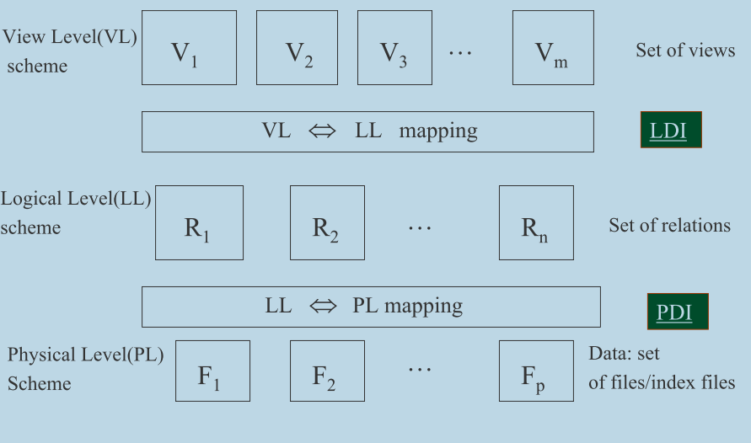
Three-Schema Architecture
Proposed to support DBMS characteristics of:
  Program-data independence.
  Support of multiple views of the data.

Slide 27
Three-Schema Architecture
Defines DBMS schemas at three levels:
  Internal schema at the internal level to describe physical storage structures and access paths. Typically uses a physical data model.
  Conceptual schema at the conceptual level to describe the structure and constraints for the whole database for a community of users. Uses a conceptual or an implementation data model.
  External schemas at the external level to describe the various user views. Usually uses the same data model as the conceptual level.

Slide 28
Three-Schema Architecture
Mappings among schema levels are needed to transform requests and data. Programs refer to an external schema, and are mapped by the DBMS to the internal schema for execution.

Slide 29
Data Independence
Logical Data Independence: The capacity to change the conceptual schema without having to change the external schemas and their application programs.
Physical Data Independence: The capacity to change the internal schema without having to change the conceptual schema.
When a schema at a lower level is changed, only the mappings between this schema and higher-level schemas need to be changed in a DBMS that fully supports data independence. The higher-level schemas themselves are unchanged. Hence, the application programs need not be changed since they refer to the external schemas.

Slide 30

DBMS Roles
application
program(s)
application
program(s)
application
program(s)
application
program(s)
application developers
users of
the data
query processor
security manager
concurrency manager
index manager
DBMS
system
developers
system
administrator
(and DB
designer)
database
designer
data
definition
processor
data
dictionary
data

Slide 31
Database Users
Users may be divided into those who actually use and control the content (called “Actors on the Scene”) and those who enable the database to be developed and the DBMS software to be designed and implemented (called “Workers Behind the Scene”).
Actors on the scene
  Database administrators: responsible for authorizing access to the database, for co-ordinating and monitoring its use, acquiring software, and hardware resources, controlling its use and monitoring efficiency of operations.

Slide 32
Database Users
Database administrators:
Coordinates all the activities of the database system; the database administrator has a good understanding of the enterprise’s information resources and needs.
Database administrator's duties include:
  Schema definition
  Storage structure and access method definition
  Schema and physical organization modification
  Granting user authority to access the database
  Specifying integrity constraints
  Acting as liaison with users
  Monitoring performance and responding to changes in requirements

Slide 33
Database Users
  Database Designers: responsible to define the content, the structure, the constraints, and functions or transactions against the database. They must communicate with the end-users and understand their needs.
  End-users: they use the data for queries, reports and some of them actually update the database content

Slide 34
Categories of End-users
Casual : access database occasionally when needed
Naïve or Parametric : they make up a large section of the end-user population. They use previously well-defined functions in the form of “canned transactions” against the database. Examples are bank-tellers or reservation clerks who do this activity for an entire shift of operations.

Slide 35
Categories of End-users Contd..
Sophisticated : these include business analysts, scientists, engineers, others thoroughly familiar with the system capabilities. Many use tools in the form of software packages that work closely with the stored database.
Stand-alone : mostly maintain personal databases using ready-to-use packaged applications. An example is a tax program user that creates his or her own internal database

Slide 36
Database Users
Users are differentiated by the way they expect to interact with the system
Application programmers – interact with system through DML calls
Sophisticated users – form requests in a database query language
Specialized users – write specialized database applications that do not fit into the traditional data processing framework
Naïve users – invoke one of the permanent application programs that have been written previously
  E.g. people accessing database over the web, bank tellers, clerical staff

Slide 37
Database Administrator
Coordinates all the activities of the database system; the database administrator has a good understanding of the enterprise’s information resources and needs.
Database administrator's duties include:
  Schema definition
  Storage structure and access method definition
  Schema and physical organization modification
  Granting user authority to access the database
  Specifying integrity constraints
  Acting as liaison with users
  Monitoring performance and responding to changes in requirements

Slide 38
Transaction Management
A transaction is a collection of operations that performs a single logical function in a database application
Transaction-management component ensures that the database remains in a consistent (correct) state despite system failures (e.g., power failures and operating system crashes) and transaction failures.
Concurrency-control manager controls the interaction among the concurrent transactions, to ensure the consistency of the database.

Slide 39
Storage Management
Storage manager is a program module that provides the interface between the low-level data stored in the database and the application programs and queries submitted to the system.
The storage manager is responsible to the following tasks:
  interaction with the file manager
  efficient storing, retrieving and updating of data

Slide 40

Overall System Structure

Slide 41

Application Architectures
Two-tier architecture: E.g. client programs using ODBC/JDBC to
communicate with a database
Three-tier architecture: E.g. web-based applications, and
applications built using “middleware”

Slide 42
When not to use a DBMS
When no DBMS may suffice:
  If the database system is not able to handle the complexity of data because of modeling limitations
  If the database users need special operations not supported by the DBMS.

